Slide 1
Ontology Driven
Data Collection for EuPathDB
Jie Zheng
Center for Bioinformatics
University of Pennsylvania School of Medicine
2011 ICBO OBI Tutorial

Slide 2
What will be covered in this use case
How to design a data submission form based on an ontology model
  Example: Form to collect sequence data and information on isolates of pathogens
How to reduce user effort in submission using restrictions defined in an ontology
  Example: restrictions defined in OBI:assay and its subclasses

Slide 3
Issues Associated with Data Collection
Heterogeneity of free text
Difficulty in data integration, requires human intervention
Complex queries are limited

Slide 4
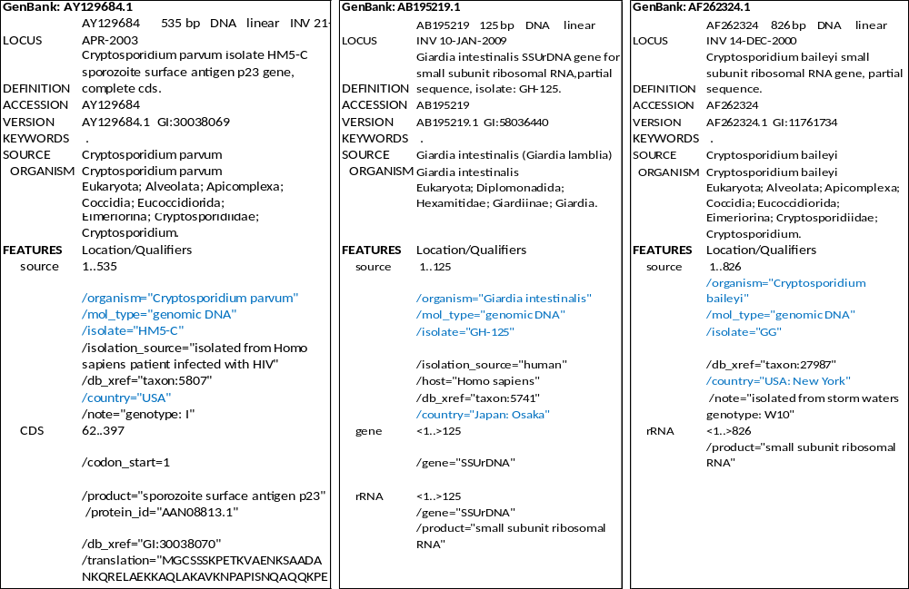
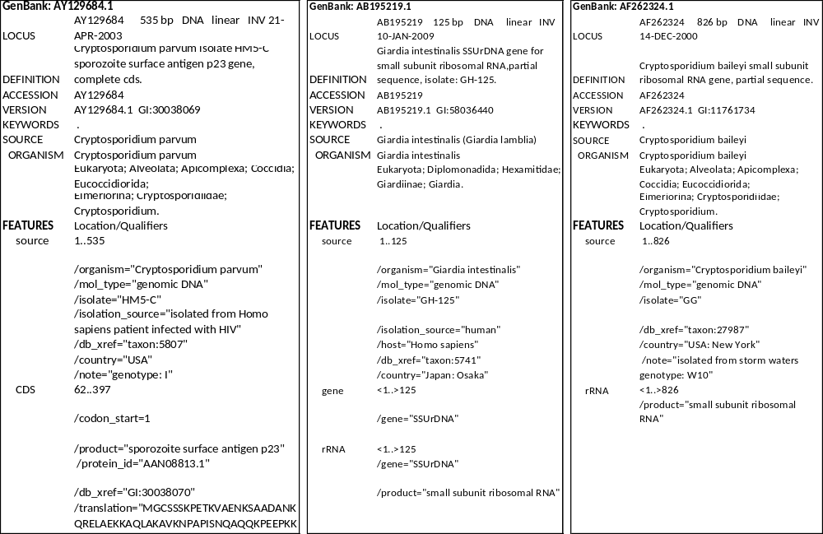
GenBank Sequence Data
Notes:
Isolation source: 3. put in the note
Host information: 1. get from Isolation source,

Slide 5
Goal
Collect well structured data with consistent annotations
Meanwhile, aim to reduce the user efforts in submission
Example:
Isolate submission form for EuPathDB
  Project with Omar Harb and Chris Stoeckert

Slide 6
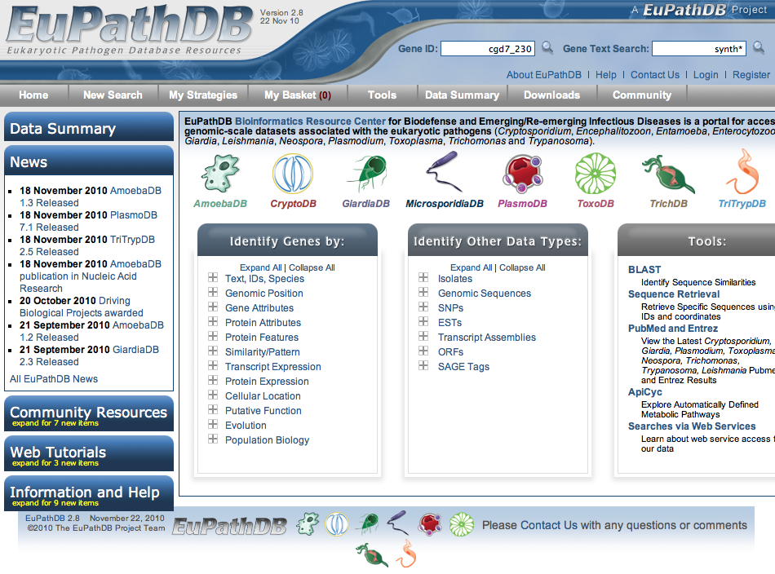
EuPathDB
One of five National Bioinformatics Resources Centers (BRCs) supported by NIH/NIAID, containing protozoan parasite genomic and functional genomic data
Mission is to enable researchers worldwide to identify and prioritize candidate targets for further research in the lab, field and clinic.
EuPathDB: a portal to
eukaryotic pathogen
databases. Aurrecoechea C, et al.
Nucleic Acids Res. 2010

Slide 7
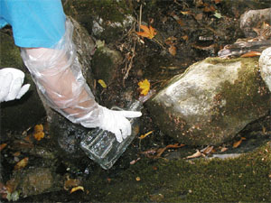
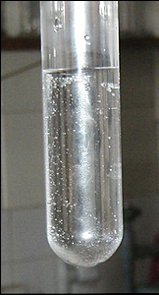
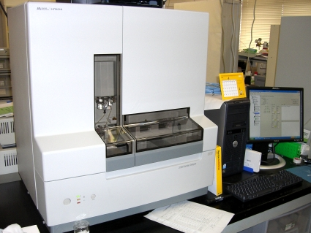
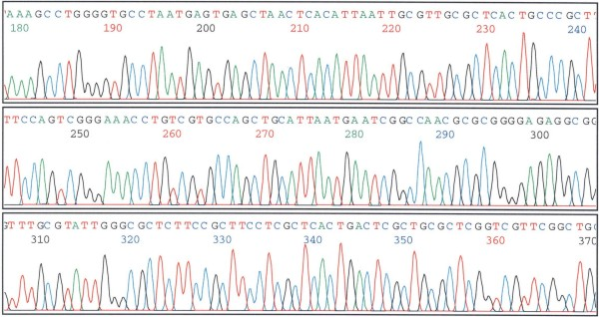
Isolate Data
Isolate: microorganisms (parasites) isolated from an environmental source (e.g.pool) or host material (e.g. human blood)
The genetic characteristics of an isolate can be identified through a sequencing assay
collect
specimen
Sequencing
assay
parasite
Which type of parasite(e.g. species, subtype, strain, genotype) was in the isolate specimen?

Slide 8
Current Issues of Isolate Data
  Need to import and integrate datasets from GenBank
  GenBank does not specify needed metadata for isolates
Manual curation required
  Harmonize: enable host queries: Human-> Homo sapiens
  Deconvolute descriptions in free text: isolated from storm waters, isolated from Homo sapiens patient infected with HIV
Notes:
Completeness of isolate data depending on submitter

Slide 9
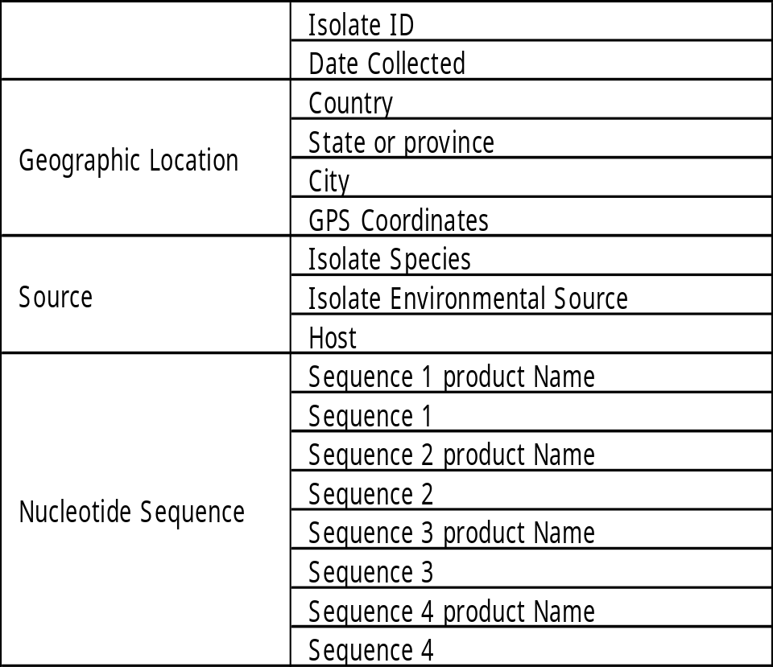
Isolate Submission Form
Isolate information
  Target isolate information
  Geographic location
  Source organism samples information
  or Environmental samples information
  Sequence information
  These data are important for parasite epidemiology.

Slide 10
Ontology Based Model
Identify ontology parent classes of data or information
Apply the ontology defined relations to reveal the interconnection of data or information collected
The model will help
Clarify what data or information will be collected
Identify the data or information needed to be collected
Notes:
Capture all the important information of isolate

Slide 11
Main Components of OBI and Their Relations
site
is_a independent
_continuant
located in
has specified input
material entity
is_a independent
_continuant
planned process
is_a occurrent
has specified output
inheres in
is about
information content entity (ICE)
quality
is_a dependent_
continuant
is about
Notes:
Main components (high level OBI classes) for drawing ontology based model

Slide 12
Ontology Based Model of Isolate Data
ICE
Isolate ID
denotes
Process
ICE
is about
Date Collected
OBI:
Specimen
Creation
Process
site
Geographic Location
(Country, State, etc.)
has_specified_input
Isolate
Environmental
Source
Located_in
qualities of host organism: sex, age, etc.
OBI:
Specimen
(Isolate
Specimen)
has_specified_output
material
entity
Source
has_specified_input
other inputs:
PCR primers
Host
has_specified_input
organism
Isolate Species
has_part
OBI: Assay
(DNA
Sequencing)
other
information:
Subtype, etc
Product Name
denotes
Protein
ICE
dependent
continuant
Nucleotide
Sequence
inheres in
DNA
derives_from
ICE
Sequence
has_specified_output
is about
Notes:
Process central ontology, process will link the material entities

Slide 13
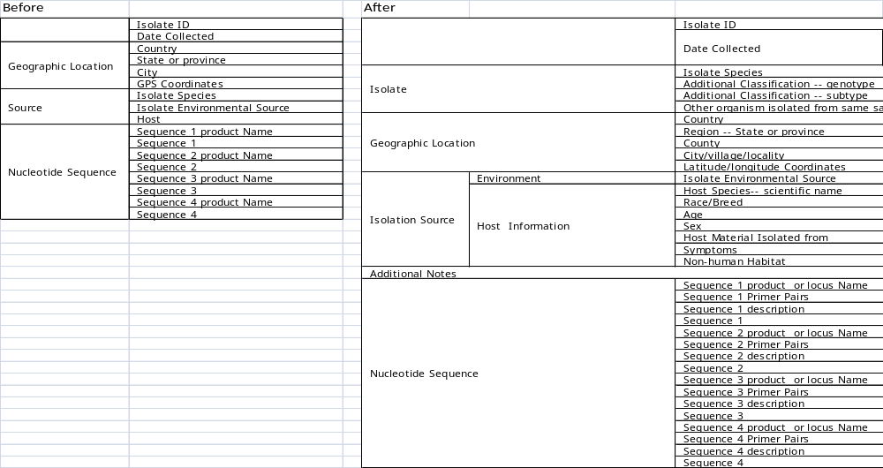
Isolate Submission Form
Isolate submission form
Support multiple sequences submission to GenBank with a parser
Notes:
Isolate ID: not clear what it refers to
Specimen id
target isolate id
sequence id (which it is in EuPathDB)
Sequence description: (required by GenBank)
complete sequence
partial sequence
partial cds
unknown

Slide 14
Ontology Chosen for Annotation
OBO foundry library ontologies
  Interoperable
  Easy for integration
Community preferred/well-defined ontologies

Slide 15
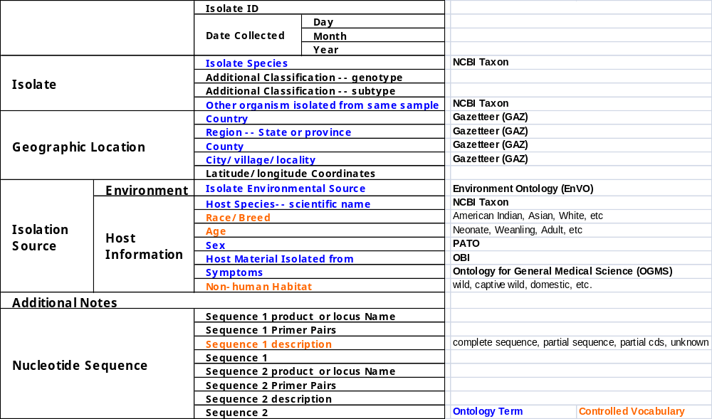
Ontology Selection
Notes:
Isolate ID: not clear what it refers to
Specimen id
target isolate id
sequence id (which it is in EuPathDB)
Sequence description: (required by GenBank)
complete sequence
partial sequence
partial cds
unknown

Slide 16
Reduce User’s Efforts in Submission using Restrictions Defined in Ontology
Limit ontology terms used in annotation based on the restrictions of terms
Example:
  Assay

Slide 17
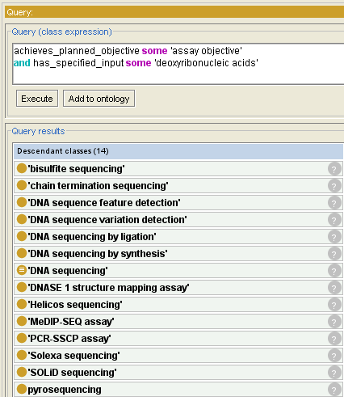
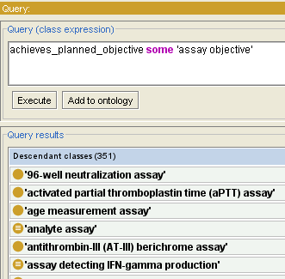
Examples: Assay
OBI – 3433
OBI: assay – 351
DNA related OBI: assay – 14
Assay with input - DNA
Assay
Notes:
OBI is one of biomedical ontologies that contains rich axioms. Most of terms are defined logically. For example, DNA sequencing, - participant DNA sequencer, input, DNA, output – sequence data, planned process achieve assay objective

Slide 18
Summary – lessons from this use case
How to draw ontology based model
How to design a data collection form based on an ontology model
How to choose ontologies to be used for annotations collected in the forms
Reduce user’s efforts in finding ontology terms for annotation using restrictions defined in the ontology
Notes:
EupathDB, data we want to collect and issues we have now

Slide 19
Acknowledgements
Chris Stoeckert Lab
  Chris Stoeckert
  Omar Harb
EuPathDB team

